Slide 1
Optimal sizing of supercapacitors for HEV’s
Sai Gopal Addagarala
21060080
Supervisor: Christos Kalyvas

Slide 2
introduction
WHY SUPERCAPACITORS?
Discharge or charge faster than batteries.
They also offer 10 to 100 times the energy density (Wh/Kg) of conventional capacitors.
Can deliver 10-20 times more power typically have 10 times the specific power (W/kg) as well as a much lower charge time when compared to lead acid batteries.
Ragone plot of the energy storage domains[1]

Slide 3

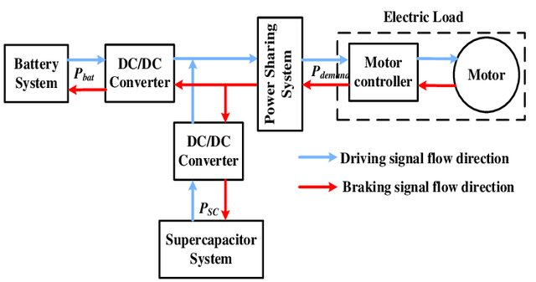
Aim
Objectives
To model optimized supercapacitor bank for hybrid electrical vehicle.
i. To investigate and model the characteristics of supercapacitors, with non-ideal equivalent circuit model for supercapacitor bank under constant power demand.
ii. Employ numerical iterative method to determine number of cells are required for non-ideal supercapacitor model.
iii. Enhance initial model by incorporating a branch term to account for leakage effects.
iv. Compare with MATLAB script code with numerical results
v. Validate with experimental data.
3

Slide 4
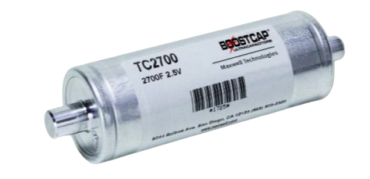
Factors to consider SC's
• Peak capacitor voltage,
• Allowable maximum percentage discharge,
• Peak current flowing through the capacitor,
• Capacitor time constant (τ),
• Capacitance per cell,
• Cell voltage,
• Number of cells needed,
• Mass of the cell,
• Cost of the cell.
Maxwell 2700F, 2.5V SC [3]
4

Slide 5
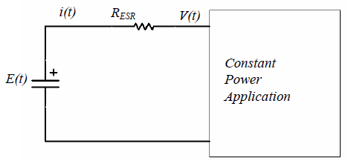
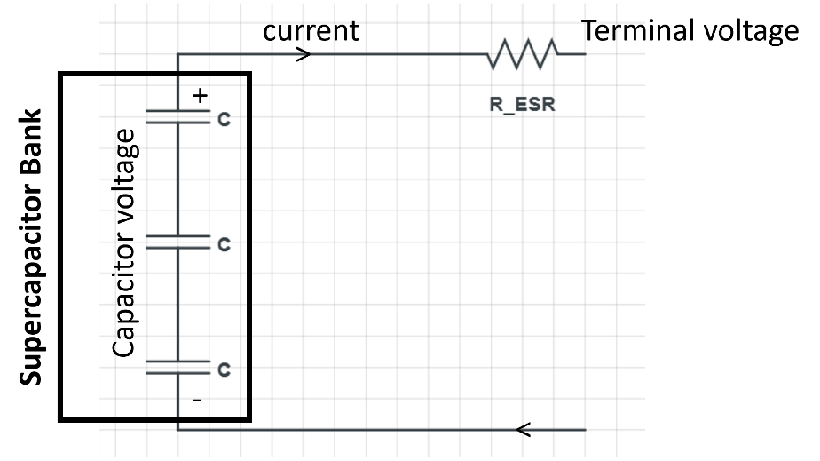
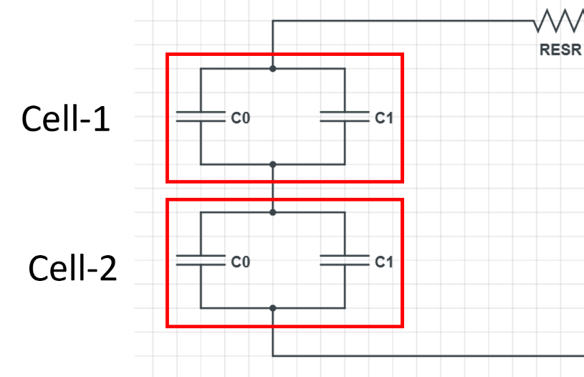
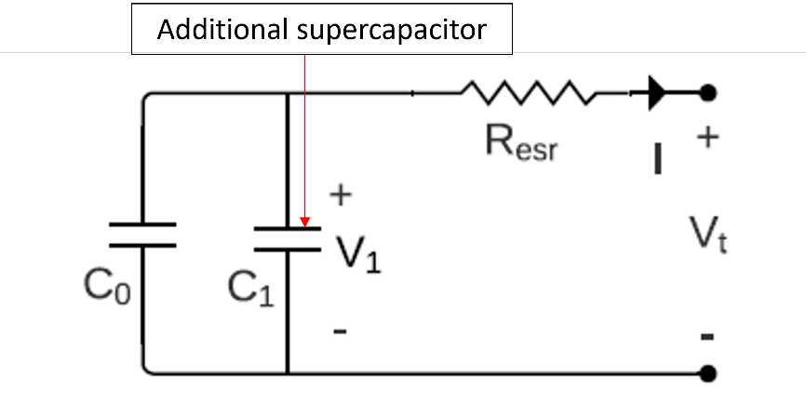
methodology
Equivalent circuit including ESR [4]
Non-ideal model development
Numerical analysis
Script code development of non-ideal model to compare with numerical results
Two branch model development
Obtaining experimental data
from valid research paper
Validation of both models with implicit data.
Non-Ideal ECM
Supercapacitor Bank
Two branch model[5]
Two branch ECM
5

Slide 6
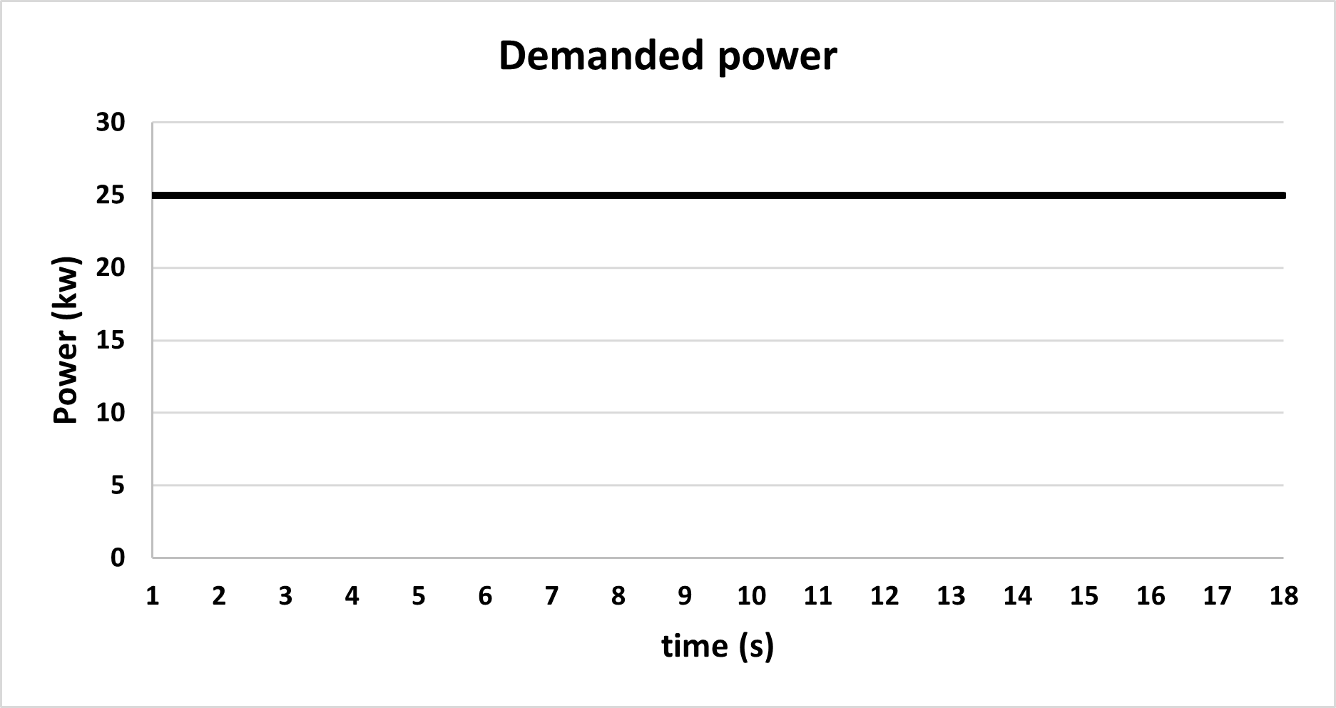
Application
For demanded power of 25kW for 18s.

Slide 7
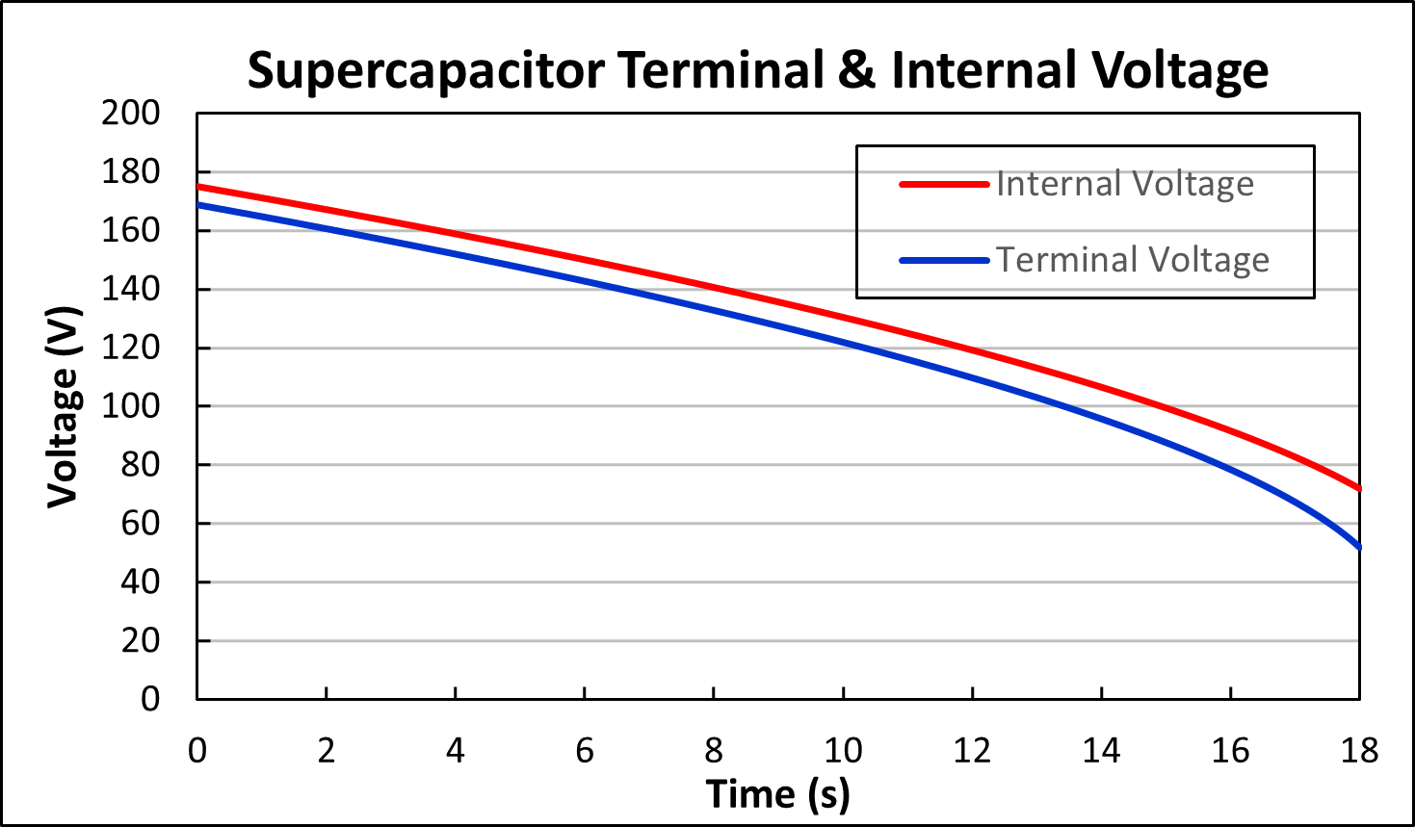
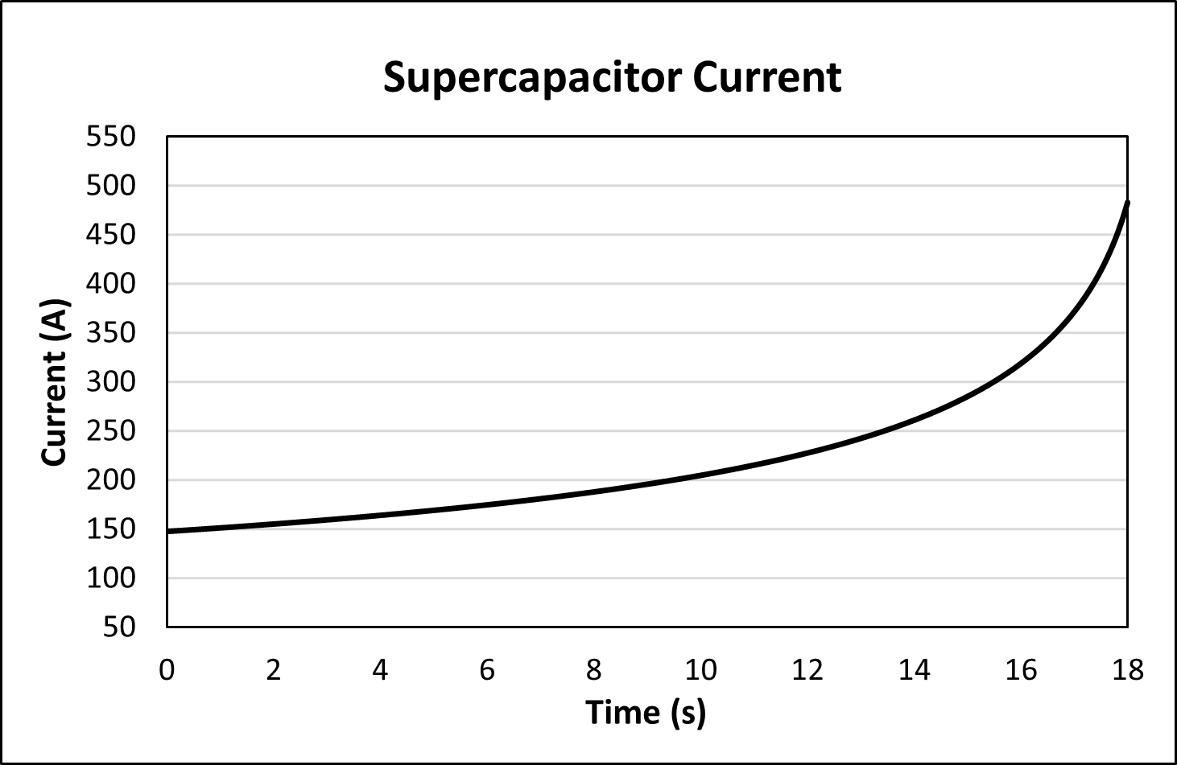
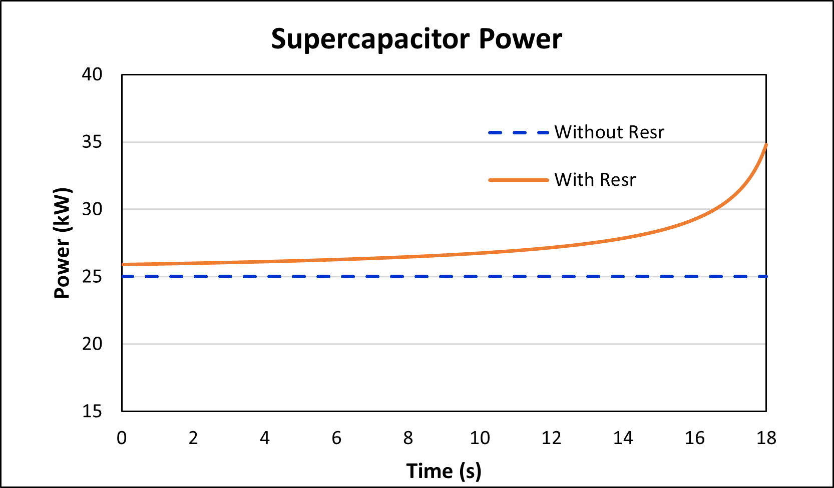
Non-ideal model analytical results
The model estimates minimum of 70 units of SC cells. At 18s, 483.09A of current shows this causes a 20.29V voltage drop. So, the "resistive loss power" at 18s is 20.29 V * 483.09A = 9.80 kW.
Adding the 25kW load power and 9.80KW resistive loss power gives the 34.80kW instantaneous power peak.

Slide 8
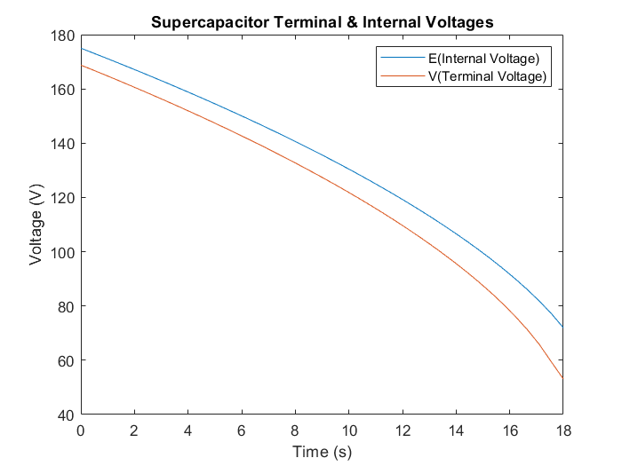
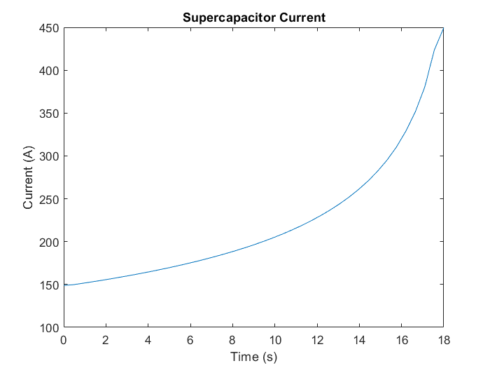
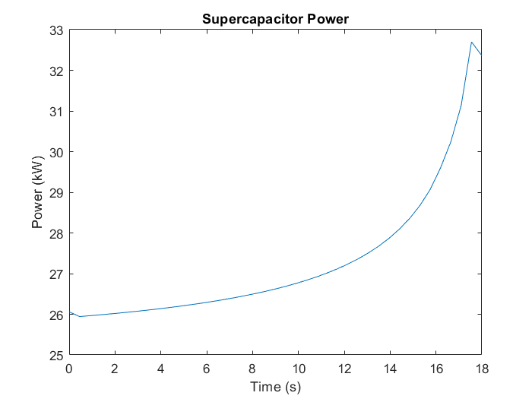
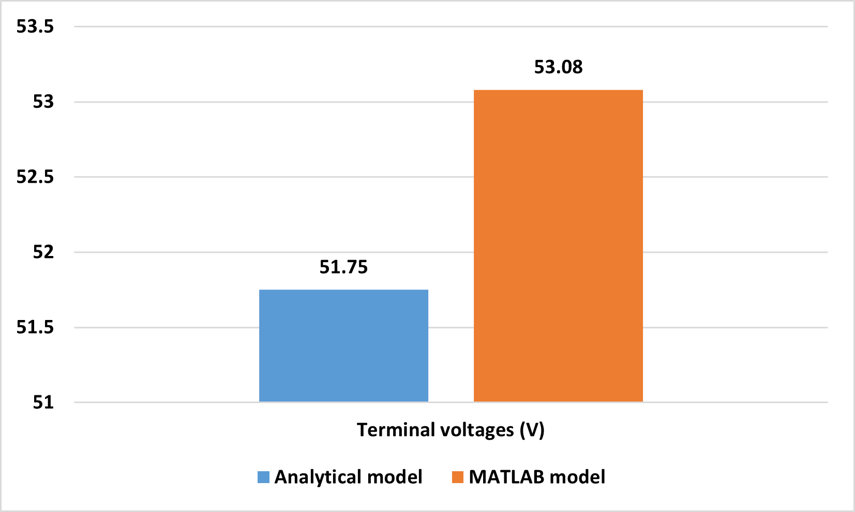
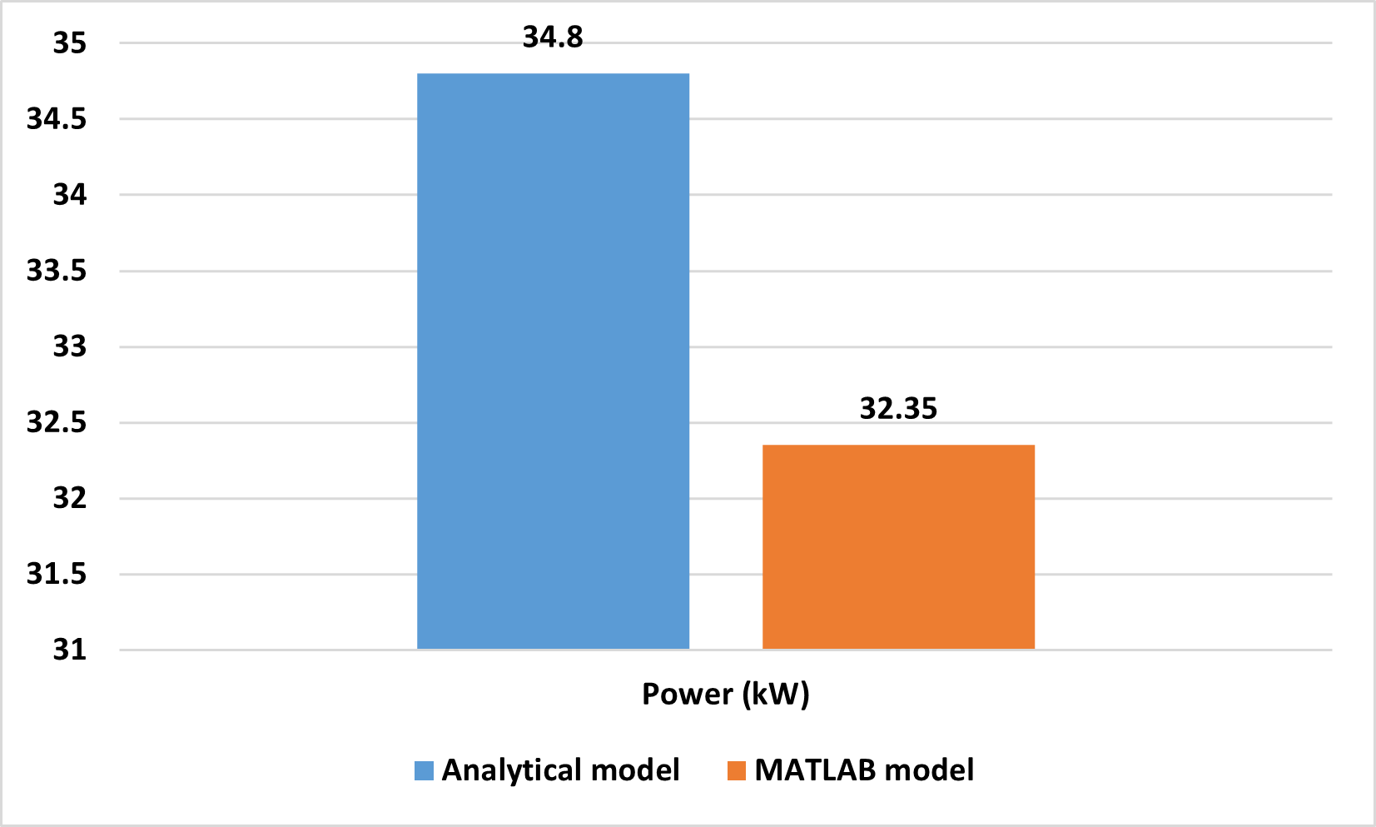
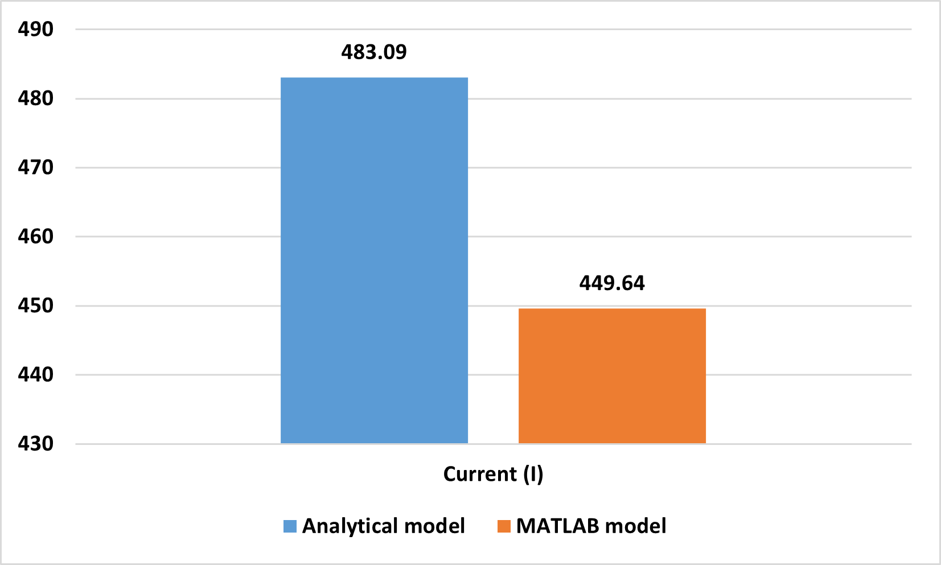
Non-ideal model
MATLAB results

Slide 9
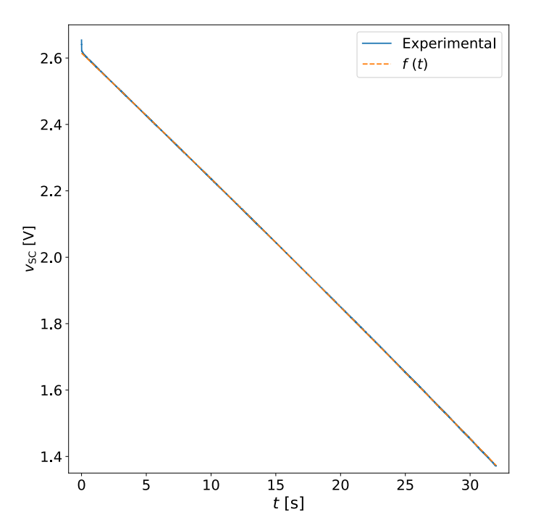
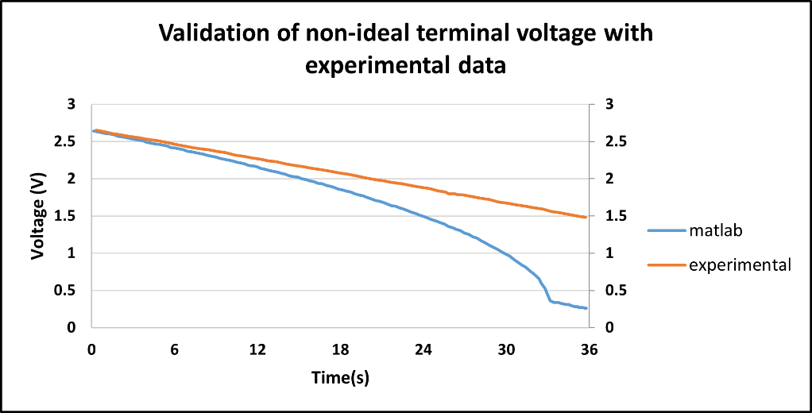
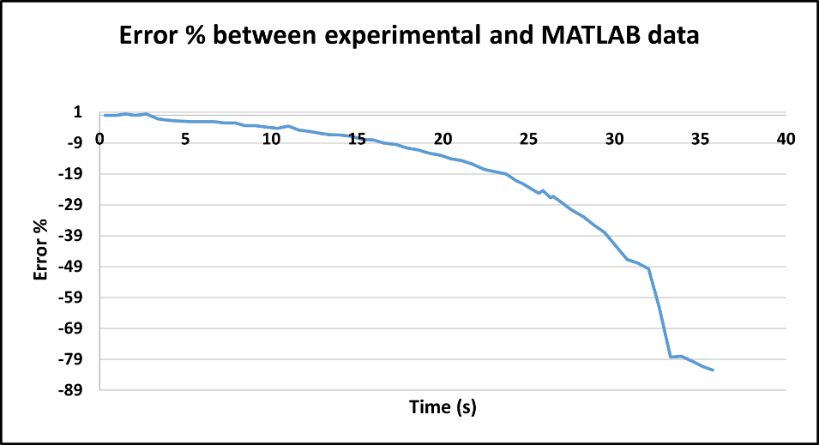
Experimental data vs
Non-ideal model
validation
Experimental graph for validation [6]

Slide 10
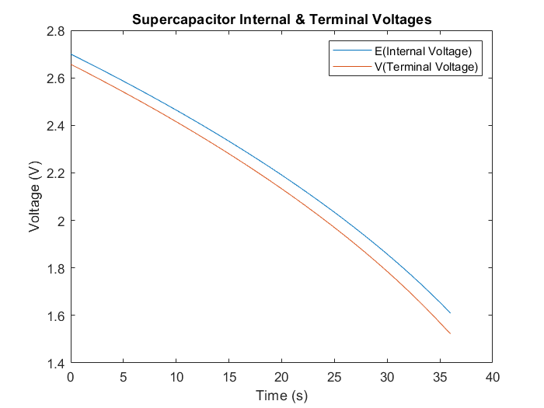
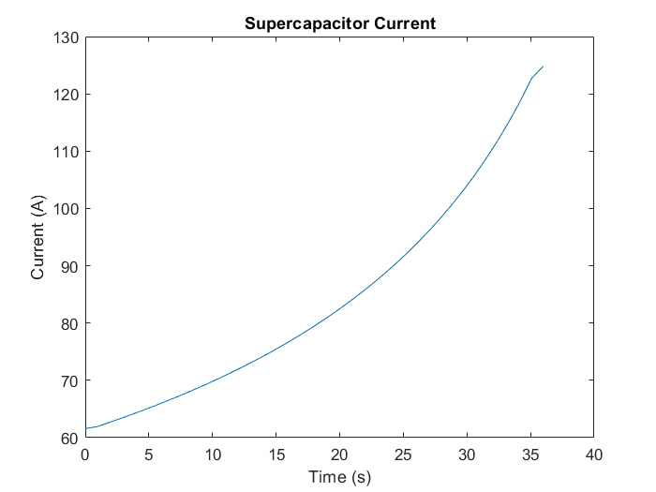
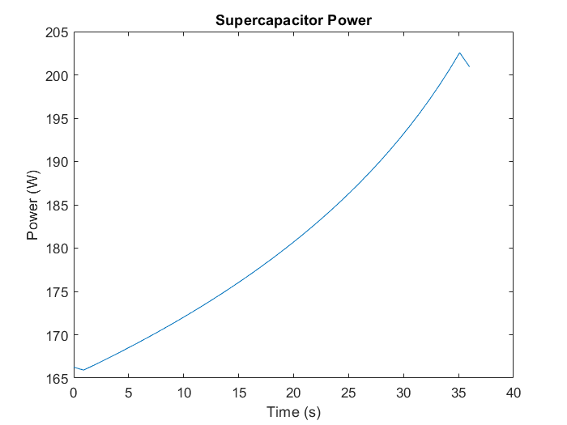
Two branch model results
Two branch model[3]

Slide 11
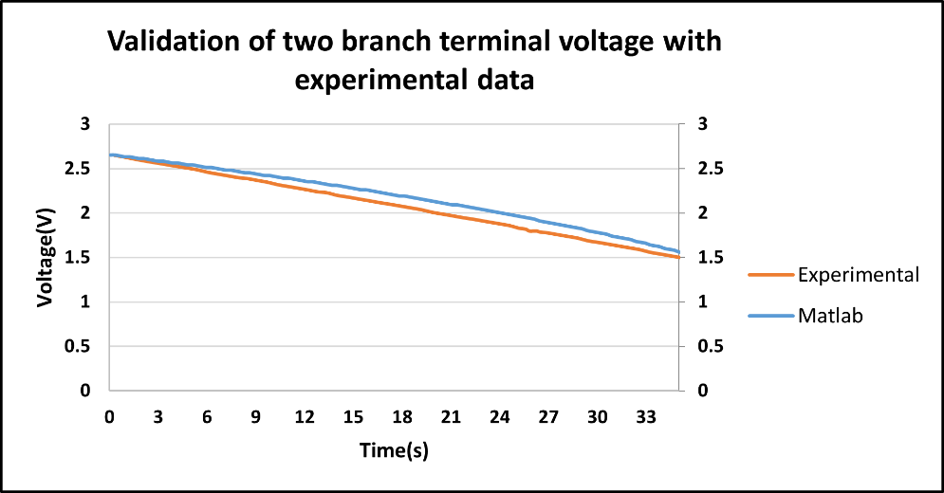
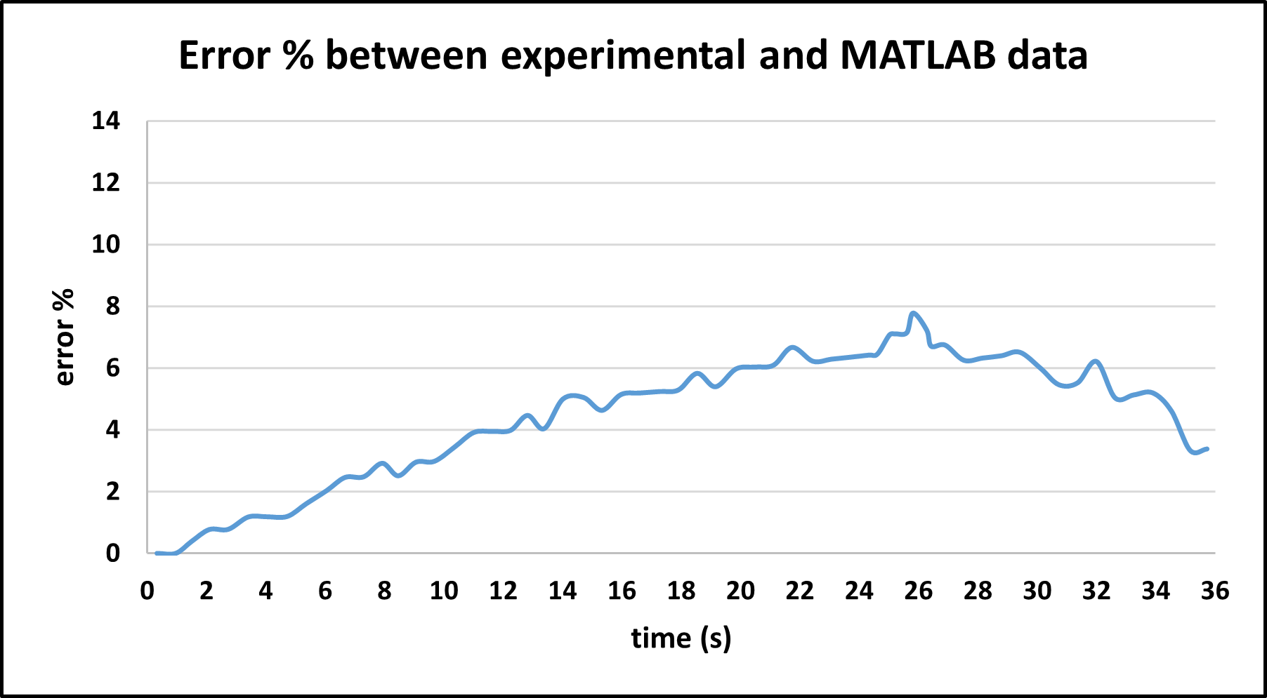
Experimental data vs two branch model
validation

Slide 12
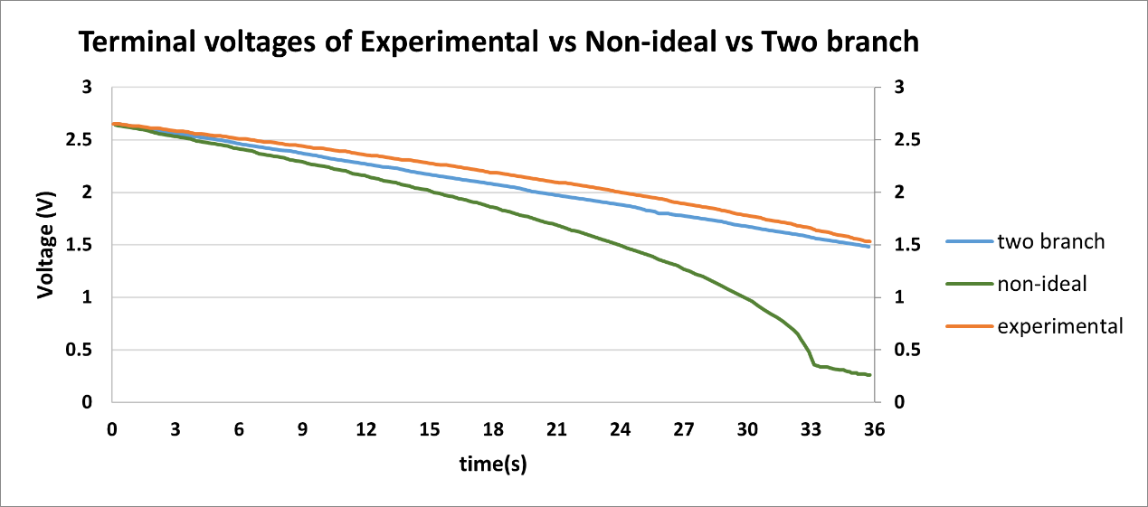
validation

Slide 13
THANK YOU
Sai Gopal Addagarala
21060080
sa22abc@herts.ac.uk

Slide 14
references
[1] J. Libich, J. Máca, J. Vondrák, O. Čech, and M. Sedlaříková, “Supercapacitors: Properties and applications,” J Energy Storage, vol. 17, pp. 224–227, Jun. 2018, doi: 10.1016/j.est.2018.03.012.
[2] Q. Zhang and W. Deng, “An adaptive energy management system for electric vehicles based on driving cycle identification and wavelet transform,” Energies (Basel), vol. 9, no. 5, 2016, doi: 10.3390/en9050341.
[3] “TC2700 BOOSTCAP ® Ultracapacitor.” [Online]. Available: www.maxwell.com
[4] H. Douglas and P. Pillay, “Sizing Ultracapacitors For Hybrid Electric Vehicles.”
[5] S. Bansal, P. Nambisan, P. Saha, and M. Khanra, “Effect of Supercapacitor Modelling and Unit Cell Capacitance Selection Towards Economic Sizing of Energy Storage System in Electric Vehicle,” J Energy Storage, vol. 51, Jul. 2022, doi: 10.1016/j.est.2022.104517.
[6] S. Marin-Coca, A. Ostadrahimi, S. Bifaretti, E. Roibas-Millan, and S. Pindado, “New Parameter Identification Method for Supercapacitor Model,” IEEE Access, vol. 11, pp. 21771–21782, 2023, doi: 10.1109/ACCESS.2023.3250965.

Slide 15

Project management & engagement

